Slide 1

Branch Prediction policies and performance comparisons
Team Members -
Bhavana Kurra
Teja Sree Sai Durga Vallabhaneni
VijayaSimha Reddy Bheemireddy
Rohan Somisetty
Rohith Reddy Venna
Key paper name - An empirical study on performance of branch predictors with varying storage budgets
Key paper link - https://ieeexplore-ieee-org.aurarialibrary.idm.oclc.org/document/830391

Slide 2
Contents of key research paper
Authors and their Organizations
Detailed study of Gshare predictor
Detailed study of Local history based two-level predictor
Detailed study of Perceptron predictor
Detailed study of LTAGE predictor
Detailed study of ISL-TAGE predictor
Experimental Setup
Metrics for performance measure
Results
Conclusion and Observations

Slide 3
Authors and their Organizations
Author | Organization
Moumita Das | Indian Statistical Institute, India
Ansuman Banerjee | Indian Statistical Institute, India
Bhaskar Sardar | Jadavpur University, India

Slide 4
Overview
The objective of our research presentation is to understand the various branch prediction policies and comparison of their performance in terms of storage budgets. Initially, we advocate the necessity and importance of branch prediction policies. Later, we elucidate various types of branch prediction policies with their advantages and disadvantages. We conclude by describing the metrics that we use for the comparison of these branch prediction policies and their performance.

Slide 5
Background
Instruction pipelining is required in computers in order to implement complex instructions. Branch instruction is used to implement the control flow in program loops. A condition where the program instruction executes if the previous instruction evaluates is called Control dependency. Control hazard might rise from control dependency. Branch Prediction is a way of handling control dependencies.

Slide 6
Background
What is an instruction pipeline?
In order to implement complex instructions, we require instruction pipelining in the computers. Both in the data stream and in the instruction stream, pipeline processing can occur. In general, an instruction pipeline reads consecutive instructions of the current instruction from the memory while the current or previous instructions to the current instruction are being implemented in the other segments.

Slide 7
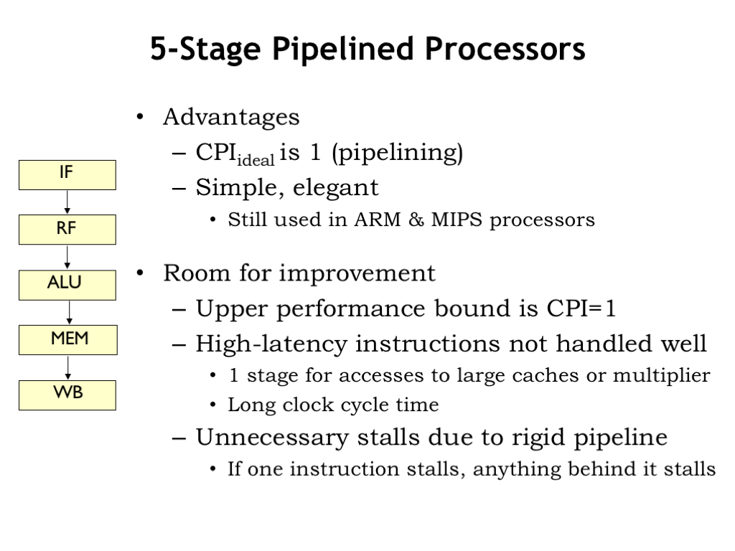
Background
Steps of Instruction Execution cycle -
In order to implement complex instructions, the computer need other steps other than just fetching and executing instructions. The following are steps of an instruction execution cycle(for MIPS) -
Instruction Fetch (IF)
Instruction Decode (ID)
Execute (EX)
Memory (MEM)
Write Back (WB)

Slide 8
Background
What is a branch instruction?
Typically, a computer has a default behavior of executing the instructions in the order whereas a branch instruction tells the computer to execute a different instruction sequence. In summary, A branch instruction changes the sequence of instructions executed and is used to implement the control flow in program loops and conditional.
Branch instructions can be both at the high-level programming language level or at the CPU level. If statements, for loops, while loop, go-to statements are examples of the branch instructions in the high-level programming languages. Jump instruction, call instruction, return instruction are examples of a machine level/CPU level branch.
Branch instructions can be both conditional and unconditional.

Slide 9
Background
Definition and Example for JUMP branch instruction
A conditional jump instruction transfers the program sequence to the given memory address/label only if a defined condition is satisfied whereas an unconditional jump instruction transfers the program sequence to the given memory address.
Example (of an unconditional jump condition) –
MOV A, 00
MOV B, 01
L13:
ADD A, B //adding B to A
JMP L13

Slide 10
Background
Definition and Example for CALL branch instruction
A call instruction pushes the address of the instruction that is next to the call instruction into a stack and then transfers the program sequence to the memory address that is specified in the operand. And the call instruction also has both the unconditional and conditional instructions.
Example –
CALL 2010 is an example of unconditional call instruction and CC 2010(Calling if carry flag is 1), CNC 2010(Calling if carry flag is 0) are examples of conditional call instructions.

Slide 11
Background
Definition and Example for RETURN branch instruction
Return instruction can be both unconditional and conditional and a return instruction transfers of the program sequence to the calling program from a subroutine.
Example –
RET is an example of unconditional return instruction. RC(Return from subroutine if carry flag is 1), RNC are examples of conditional return instructions.

Slide 12
Background
Difference between JUMP and CALL instruction?
In jump instruction, the program counter is transferred to a memory location which is the part of the main program.
Whereas in call instruction, the program counter is transferred to the memory location which is not part of the main program.

Slide 13
Background
More about BRANCH
When a branch is taken, the flow of control changes by setting the program counter(PC) of the CPU to the argument in the branch instruction such that the next instruction becomes the instruction at the memory address(that has been specified in the branch instruction). Similarly, when a branch is not taken, the program counter of the CPU and the control flow remains unchanged.^{[5]}

Slide 14
Background
How to handle branch instructions?
There are several ways to handle the branch instructions such that the negative impact on the rate of instruction execution can be reduced. Branch delay slots, Branch Prediction, Branch Free Code, Hardware Branch Predictors are the methods for handling the branch instructions.

Slide 15
Background
Branch Predictors
Software Branch Predictors
When a program is written, the programmer compiles a test version of the program whose statistics are used to optimize the code.
Disadvantage of software branch predictor –
The software branch prediction requires the complex software development process.
Hardware Branch Predictors -
The hardware branch predictors are parts of processors which have moved the statistics into electronics. They guess(predict) the outcome of a conditional branch and then modify the logic of the execution of instruction flow of the processor.

Slide 16
Background
Example of Hardware Branch Predictor/Branch Predictor -
A scheme where we assume all the forward branches are not taken(since they leave the loop) and the backward branches are taken(since it is an infinite loop)

Slide 17
Background
Advantages and Disadvantages of Branch Predictor –
The advantage of a branch predictor is that it reduces the delay if the prediction is correct.
The disadvantage of branch is that it causes more delay if the prediction is wrong.

Slide 18
Motivation
Branch predictors are used to reduce delays of conditional branch predictors. Branch predictors are used to handle control dependencies. Handling control hazards efficiently will increase the effectiveness of the instruction pipelining by decreasing the CPI(Cycles per Instruction).

Slide 19
Outline
GShare - Bhavana Kurra
Local History based two-level predictor - Teja Sree Sai Durga Vallabhaneni
Perceptron predictor – Vijayasimha Reddy Bheemireddy
LTAGE – Rohan Somisetty
ISL-TAGE – Rohith Reddy Venna

Slide 20
Background – Gshare (McFarling introduced Gshare)
What is a Dynamic Branch Prediction?
In order to predict future, a Dynamic Branch Predictor uses past behavior. That is, a dynamic branch predictor uses a history table which is used to predict whether a branch is taken or not-taken. Dynamic branch predictor information may change during the course of running a program.

Slide 21
Background - Gshare
Dynamic Branch prediction Schemes
Two-bit Counter Branch Prediction Scheme, Bimodal Branch Prediction Scheme, Correlated Branch Prediction Scheme, Global Branch Prediction Scheme, Local Branch Prediction Scheme, Global Selection Branch Prediction Scheme, Global Sharing Branch Prediction Scheme, etc are some of the dynamic branch prediction schemes.^{[7]}

Slide 22
Background – Gshare
What is a global branch predictor?
Unlike local branch predictors, A global branch predictor maintains a shared history for all conditional jumps. In order to make a good prediction, the history buffer must be longer enough and the pattern history table grows with respect to the history buffer. In summary, A global branch predictor predicts based on related branches using the shared history.

Slide 23
Background – Gshare
What is a two-level branch predictor?
A two-level branch predictor uses a “pattern history table” which is a two-dimensional table of counters whose entries are two-bit counters. Correlation-Based Branch Predictor is another name for the two-level branch predictor. The two-bit counters are the entries for the Pattern History Table.^{[4][6]}

Slide 24
Background – Gshare
Types of two-level branch predictors -
Two-level adaptive predictor
Two-level neural predictors are some of the two-level branch predictors.
What is a two- level adaptive predictor?
Considering the history of last n branch occurrences, there are 2^{n} history patterns which are possible. A two-level adaptive predictor uses one saturating counter for each possible history pattern while remembering the history of last n branch occurrences.

Slide 25
Definition
Gshare which is also known as Global Sharing Branch Prediction Scheme which is a two-level adaptive predictor which has a globally shared history buffer. Gshare uses Pattern History Table/PHT and Branch History Register/BHT for the branch prediction. The BHR counter content and the two-bit counter content are updated according to the actual branch outcome after resolving a branch condition.

Slide 26
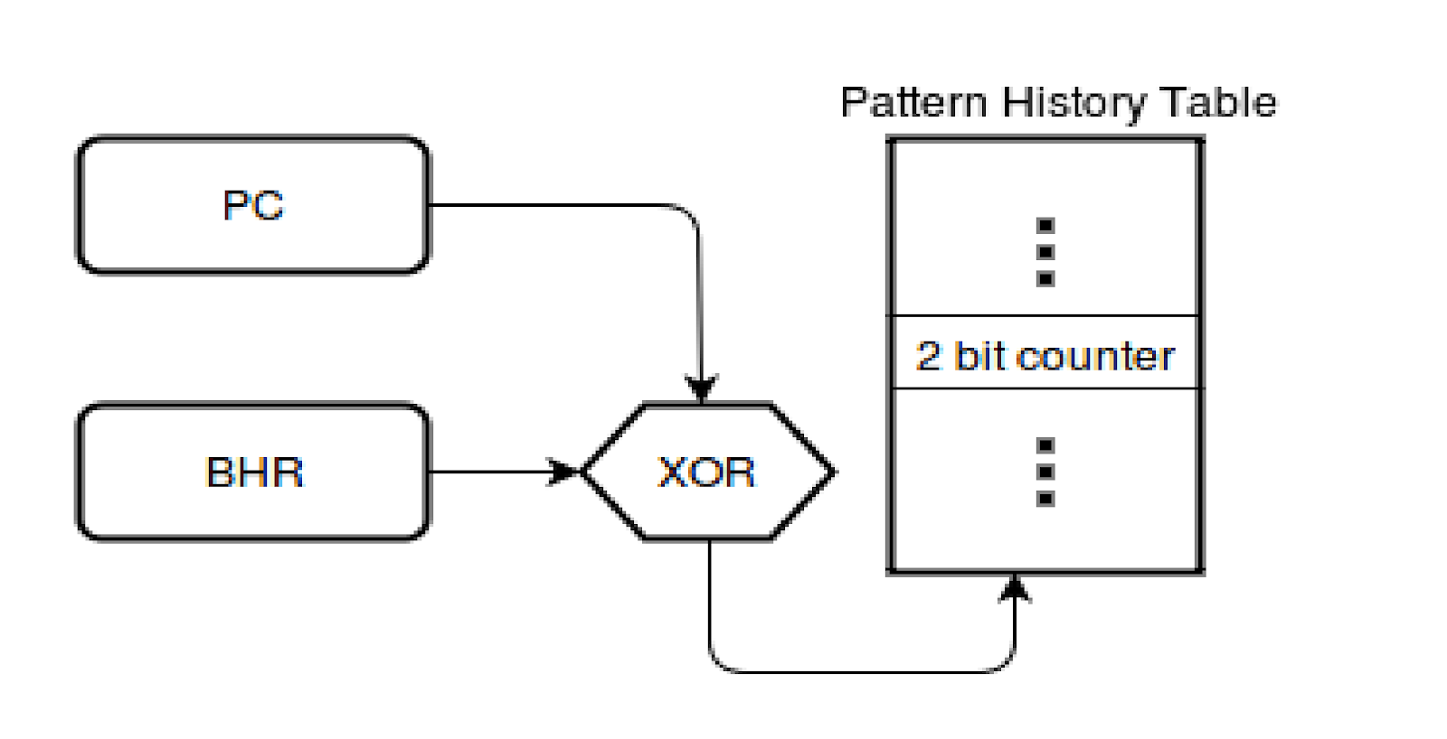
Definition
How does GShare predictor work?
A GShare predictor uses XOR gate between the program register which has the memory address and the Branch History Register.

Slide 27
Definition
What is the Branch History register(BHR)?
An n-bit shift register which contains the most recent “n branches” outcome is called the Branch History Register. For a branch, the Branch History Register records a value of 1 if the branch is taken and a value of 0 if the branch is not taken.

Slide 28
Definition
What is a Pattern history Table(PHT)?
Each entry of a Pattern History Table consists of a two-bit saturating counter. The final prediction is given by the MSB(Most significant bit) of a counter. The storage size of the predictor is dependent on the size of the PHT.

Slide 29
Advantages and Disadvantages
Advantages -
The correlation between different conditional jumps can be part of making predictions when a branch predictor has shared history.
Disadvantages -
Being sensitive to storage size. The lower storage size will lead to more negative interferences and the number of mis predictions.

Slide 30

Which processors use GShare branch prediction?
AMD
Intel Pentium M
Intel core
Intel Core 2
Silvermont-based Atom processors etc

Slide 31

Results
GShare has a prediction Accuracy of 94.1%.

Slide 32
Observations
For all the CBP-2 traces, the Mis-Prediction per Kilo Instructions(MPKI) for Gshare kept on slightly decreasing when the storage budget increases.
For all the CBP-2 traces, the latency increased for the 16KB, 32KB, 64KB storage budgets compared to that of the 2KB, 4KB and 8KB storage budgets.

Slide 33
Outline
GShare - Bhavana Kurra
Local History based two-level predictor - Teja Sree Sai Durga Vallabhaneni
LTAGE – Rohan Somisetty
ISL-TAGE – Rohith Reddy Venna
Perceptron predictor – Vijayasimha Reddy Bheemireddy

Slide 34
Objective
The objective of a branch predictor is to anticipate the direction of a branch, regardless of whether it will be taken or not taken for a given input.
Its purpose is to improve the flow of the instruction pipeline

Slide 35
Background
The two-level branch predictor is also known as a correlation-based branch predictor. It utilizes the two-dimensional table of counters known as pattern history tables.
The table entries are 2-bit counters.
The two-level branch predictor method was introduced by T.-Y. Yeh and Yale Patt at the University of Michigan. This method has become very popular from its early publication in 1991[4].
ADVANTAGE –
it can rapidly learn to predict an arbitrary redundant pattern.

Slide 36
Keywords
Dynamic branch prediction
GHR - Global History Register
PAp-Per Address pattern
PHT- Pattern history table
BHR- Branch history register
BHT -Branch history table

Slide 37
Keywords
PAg –Per address Two-Level Adaptive Branch Prediction Using a Global Pattern History table.
GAg- Global Two-Level Adaptive Branch Prediction Using a Global pattern history table.
PAp- Per address Two-Level Adaptive Branch Prediction Using Per address Pattern

Slide 38
Types of Histories
Two types of histories are used in dynamic branch prediction[8]:
Global branch prediction-
It includes the outcomes of all previous branches.
Local branch prediction-
It contains previous branch outcomes for the same branch.

Slide 39
Local history-based predictor is more popularly used in several processors than the global history-based predictor.
These history-based predictors are more resource-intensive

Slide 40
Two Level Adaptive Branch Prediction
It utilizes two levels of branch history information to make predictions.
It uses two main data structures for maintaining two levels of information.
Branch History Register(BHR) and
Pattern History Table(PHT)

Slide 41
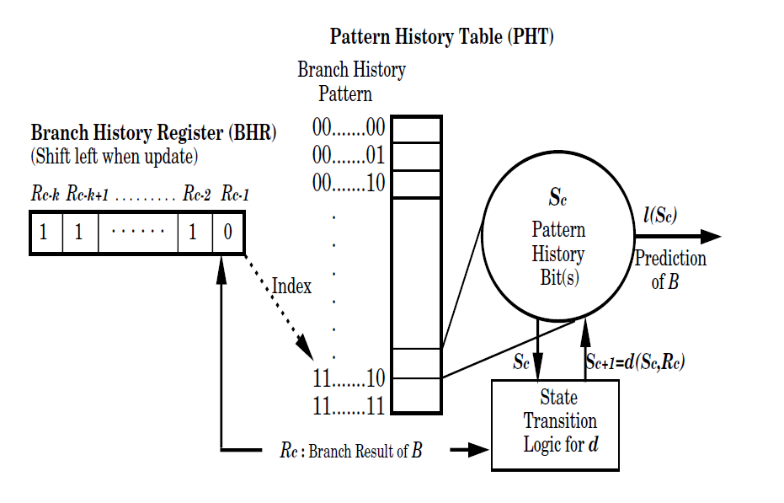
Structure of two-level adaptive branch prediction
Figure – Two level adaptive branch prediction[7]

Slide 42
Comparison of two-level adaptive schemes using history registers of the same length
Every variation in the graph is taken with same history register length. The variations involved are PAp,PAg,GAg.
PAp performs the best followed by Pag and the performance of GAg is worst.

Slide 43
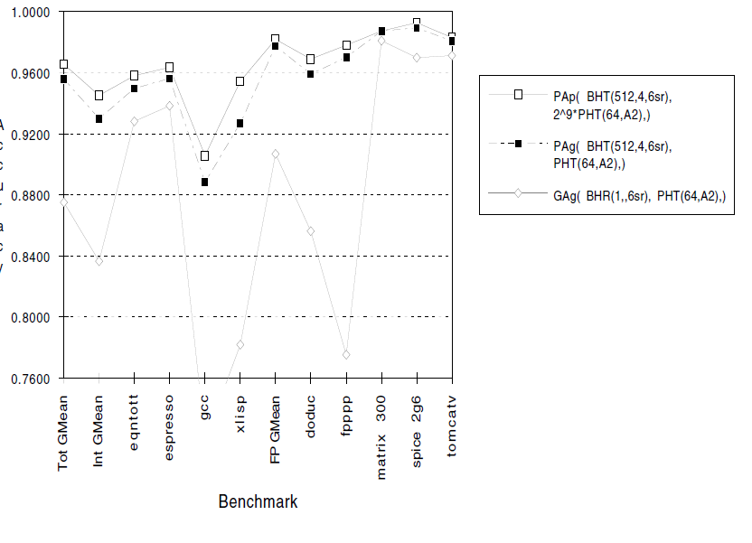
Comparison of two-level adaptive schemes using history registers of same length
Figure – From Reference[7]

Slide 44
Implementation of Two-Level Adaptive Branch Prediction
Two-Level Adaptive Branch Prediction Using a Global History Register and a Global Pattern History Table (GAg)
Two-Level Adaptive Branch Prediction Using a Per-address Branch History Table and a Global Pattern History Table (PAg)
Two-Level Adaptive Branch Prediction Using Per-address Branch History Table and Per address Pattern History Tables (PAp)

Slide 45
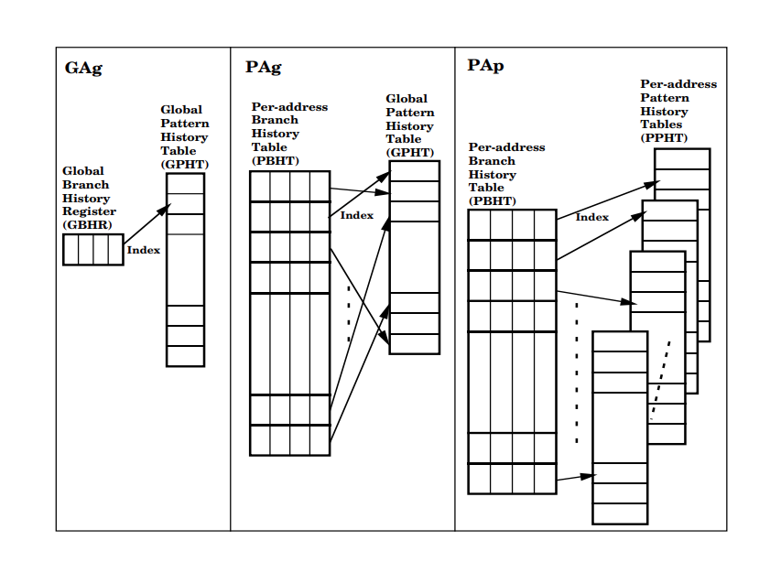
Global view of three variations of Two-Level Adaive Branch Prediction

Slide 46
Hardware cost efficiency of three variations
To achieve the prediction accuracy GAg needs 18-bit history registers, PAg requires 12-bit history registers and PAp needs 6-bit history registers.
PAp is most expensive due to multiple pattern history tables and PAg is cheapest and GAgs pattern history table is expensive when we utilize the long history register.

Slide 47
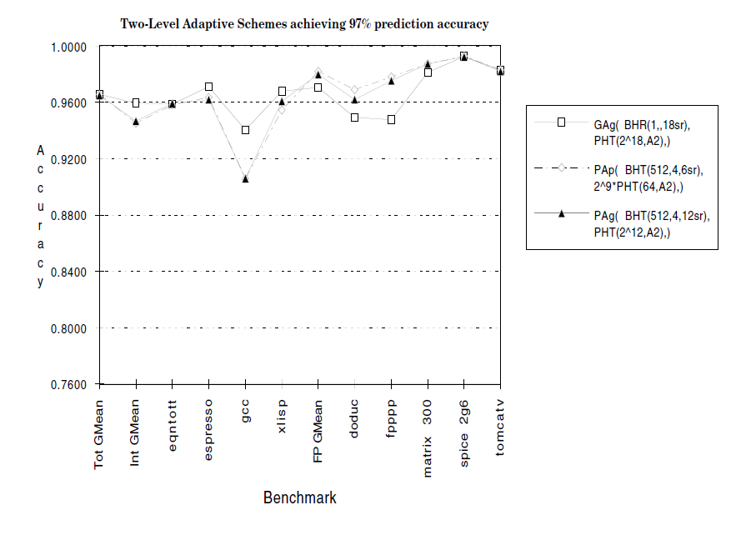
97% prediction accuracy for two level adaptive scheme

Slide 48
PAp
PAp is one of the main feature of local history based branch predictor.
It has its own BHR and PHT for each branch.
The PHT is chosen by the branch instruction address whereas the BHR content is utilized to choose the index in PHT.
The stockpiling size relies upon BHR size and per address PHT size for this predictor.
It is a union of multiple per-address BHRs and multiple per-address PHT.

Slide 49
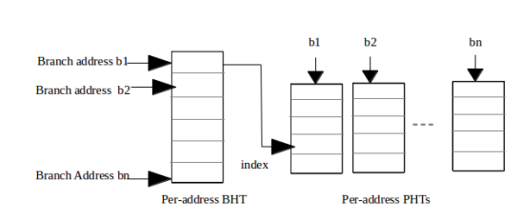
Pap Branch Predictor
Figure – From Reference[1]

Slide 50
PAp (continued..)
Small BHR size consists a smaller number of entries, increases the chance of inter-branch inference.
Small-sized per address PHT increases the chance of intra branch inference.
There is an expected increase in the number of miss- predictions because of negative inferences with smaller storage sizes.

Slide 51
Observations
Based on SPEC benchmarks[7], average prediction accuracy of TWO-level Adaptive Branch Prediction is 97% whereas for other schemes the average accuracy will be atmost 94.4% .
Based on CBP-2 benchmarks[1],
The utmost actual execution of Two-Level Adaptive Branch Prediction consumes a per-address branch history table and a global pattern history table. The performance of a two-level predictor is better for a low storage budget.
The Two-level predictor has the highest latency for all predictor sizes.
It gives better prediction accuracy in resource-constrained environments but not when comes to latency.

Slide 52
Outline
GShare - Bhavana Kurra
Local History based two-level predictor - Teja Sree Sai Durga Vallabhaneni
LTAGE – Rohan Somisetty
ISL-TAGE – Rohith Reddy Venna
Perceptron predictor – Vijayasimha Reddy Bheemireddy

Slide 53
Background
The neural based branch predictors provided a solution for effectively combining several predictions.

Slide 54
The TAGE Predictor
The TAGE predictor is called the TAgged Geometric history length branch predictor and is called a PPM-like predictor. It is an update-based predictor.^{[15]}
Either a base predictor or a match on a tagged component are used to make predictions.
Use a tag-matching table with the longest history if it has a good forecast.
Use the tag-matching table with the second-longest history if everything else fails.
This is a new and efficient predictor update algorithm
For final prediction computation, partial tagging is more efficient than adder.
At comparable storage budgets and predictor complexity, outperforms O-GEHL.

Slide 55
TAGE Conditional Branch Predictor
The TAGE predictor structures a base predictor T0 in charge of on condition that a basic prediction and a set of tagged predictor components Ti.^{[14]}
The base predictor will be a simple PC-indexed 2-bit counter bimodal table.

Slide 56
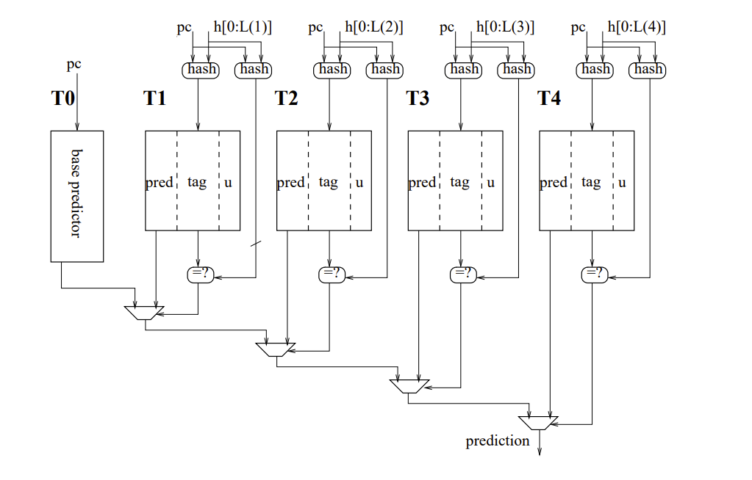
Tage Predictor

Slide 57
Prediction Computation Algorithm
The Prediction Computation Algorithm is as follows:
Find the matching component with the longest history.
If the prediction counter is not weak or USE_ALT_ON_NA is negative, then the prediction counter sign provides the prediction else the prediction is the alternative prediction.^{[14]}

Slide 58
Loop predictor component
Regular loops with a fixed number of iterations are identified.
When the loop has been successfully run three times with the same amount of iterations
The replacement policy is based on the age.
When the loop forecast has a high level of confidence, it is used.^{[16]}

Slide 59
Updating the TAGE Predictor
Updating the Useful Counter
Updating the Prediction Counters
Allocating Tagged Entries on Mispredictions

Slide 60
TAGE vs L-TAGE
From various experiments performed we can observe that there is a clear trend of decreasing MPKI with increasing Table size^{[16]}
N-component L-TAGE performs better than n-component TAGE over various table sizes

Slide 61
Varying history length
With increase in history length initially MPKI decreases(hence a larger history helps)
MPKI stagnates and then increases marginally as the maximum history time is increased.
TAGE and L-TAGE are resistant to changes in the duration of the history.
It's possible that the minor gain is due to the fact that server traces don't require a lot of history.

Slide 62
Varying tag width
More table storage will be required if the tag width is increased.
Tag widths that are too tiny will result in false tag matches, resulting in missed predictions.

Slide 63
Implementation Issues
The Implementation Issues of this predictor are -
The Prediction Response Time
Ahead Pipelining

Slide 64
Advantages
The TAGE predictor uses geometric history length series in the same way that the OGEHL predictor does, but it is more storage-efficient.
The loop predictor can capture some behaviors that aren't captured by the TAGE predictor by using only a small amount of storage.

Slide 65
Disadvantages
The correlation from very distant branch outcomes is lost when the number of tag components is reduced.
Negative interferences are more likely when the tagged component and the base predictor are smaller.
Similarly, a smaller loop predictor may not be able to correctly identify the loop behavior of all branches.

Slide 66
Outline
GShare - Bhavana Kurra
Local History based two-level predictor - Teja Sree Sai Durga Vallabhaneni
LTAGE – Rohan Somisetty
ISL-TAGE – Rohith Reddy Venna
Perceptron predictor – Vijayasimha Reddy Bheemireddy

Slide 67
Background
TAGE Predictor ^{[13]}
Loop Predictor
Statistical Corrector Predictor
Immediate Update Mimicker (IMU)

Slide 68
ISL-TAGE Branch Predictor
TAGE, Loop, Statistical Collector, and Immediate Update Mimicker (IUM) are all used together. ^{[11]}
It is TAGE that is the core of this ISLTAGE predictor
In very long histories, TAGE captures most of the correlation on branch outcomes.

Slide 69
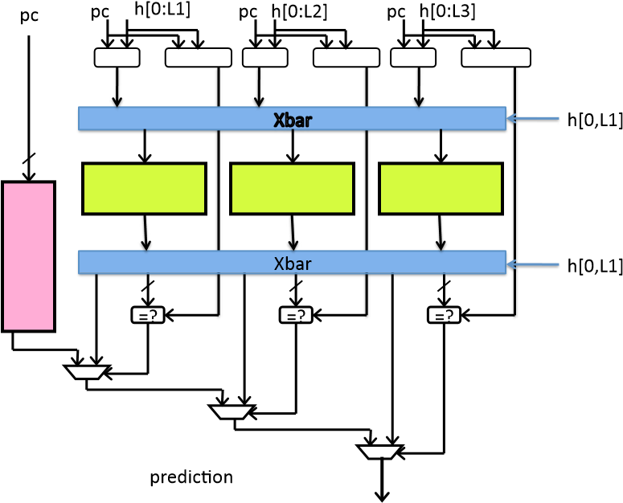
THE TAGE CONDITIONAL BRANCH PREDICTOR

Slide 70
Sharing Storage space between Predictor Tables in the TAGE Predictor
The TAGE predictor features independent logic tables.
Some tables are underutilized while others are under greater pressure for some applications.
Sharing the storage space among several tables can be implemented without a real multi-ported memory table.
The experiments showed that interleaving all tables globally is not the best solution, but that interleaving a few adjacent history lengths can be slightly beneficial.

Slide 71
Prediction Computation
At prediction time, the base predictor and the tagged components are accessed simultaneously.
The prediction is provided by the hitting tagged predictor component that uses the longest history. In case of no matching tagged predictor component, the default prediction is used.
However, we remarked that when the confidence counter of the matching entry is null, on some traces, the alternate prediction altpred is sometimes more accurate than the ”normal” prediction

Slide 72
The Loop Predictor
Predict loop with a constant number of iterations
64 entries
4-way skewed associative
less than 6 bytes per entry
Capture some behavior that TAGE is not able to

Slide 73
The Loop Predictor
Each entry consists of a
past iteration count on 10 bits
speculative and a retire iteration count on 10 bits each
partial tag on 10 bits
confidence counter on 3 bits
age counter on 3 bits and 1 direction bit i.e., 47 bits per entry.
Replacement policy is based age
Entry can be replaced only if its age counter is null.
On allocation, the age is first set to 7.
When the entry was a possible replacement target, the age of the entry was decremented. When the entry was used, the age was incremented.
Any branch determined to be not a regular loop will have its age reset to zero.

Slide 74
Statistical Corrector Predictor
ISSUE:
TAGE predictor fails to predict:
Branches that are not strongly correlated, but only statistically biased. On some of these branches, the TAGE predictor performs worse than a simple PC-indexed table of wide counters.
SOLUTION:
In order to better predict this class of statistically biased branches, we introduce the Statistical Corrector predictor.^{[12]}
The correction aims at detecting the unlikely predictions and revert them.
The Statistical Corrector predictor can be quite small.

Slide 75
Statistical Corrector Predictor for the contest
Derived from the GEHL predictor:
5 (logic) tables sharing 4K6-bit entries
+ use TAGE prediction in the index
+ values of the provider counter
Use prediction when
|sum|>dynamic threshold

Slide 76
Immediate Update Mimicker
Issue:
Some mispredictions due to late updates of predictor table at retire time.
Single predictor table entry provide several mispredictions
Solution:
Immediate Update Mimicker
Limit these extra mispredictions through predicting branches with inflight non-retired occurrences.

Slide 77
The TAGE Predictor component
For a 512 Kbits predictor, the best accuracy we found is achieved by a 16 components TAGE predictor, i.e., 15 tagged components and a base bimodal predictor.
Hysteresis bits are shared on the base predictor. Each entry in predictor table Ti features a Wi bits wide tag, a 3-bit prediction counter, and a 1-bit useful counter.

Slide 78
Drawbacks & Solutions
In some instances, however, it fails to predict loops with a constant number of iterations, so a loop predictor is incorporated to predict these loops.
TAGE has another disadvantage in that it cannot predict branches that are not strongly correlated, but only statistically biased.
This predictor also includes the Immediate Update Mimicker to prevent extra mispredictions that can arise from TAGE's delayed update at retire time.
To avoid path pollution from the wrong path, the TAGE predictor must update at retire time. This delayed update leads to extra mispredictions when compared with an optimistic fetch time update.

Slide 79
Total Predictor Storage Budget
The total storage budget for the submitted ISLTAGE predictor represents
61,696 bytes for TAGE predictor,
3,072 bytes for the Statistical Corrector predictor,
376 bytes for the loop predictor and
160 bytes for the IUM predictor, i.e. a total of 65,304 bytes.

Slide 80
Observations
ISL-TAGE predictor is better than TAGE and LTAGE because TAGE cannot predict branches that are strongly correlated

Slide 81
Outline
GShare - Bhavana Kurra
Local History based two-level predictor - Teja Sree Sai Durga Vallabhaneni
LTAGE – Rohan Somisetty
ISL-TAGE – Rohith Reddy Venna
Perceptron predictor – Vijayasimha Reddy Bheemireddy

Slide 82
Background
In 1962, the perceptron was introduced to study brain function using neural networks. We consider the simplest type of perceptron, a single-layer perceptron consisting of an artificial neuron connecting multiple input units by weighted edges to an output unit.^{[2]}

Slide 83
Related Work
The effortlessness of the perceptron makes it appropriate to branch expectation issues.
For a given time which is allotted for prediction, a smaller number of computations can be done because of the short clock cycles of current state-of-art processors. This makes the accessible amount of data within the given prediction time limited.
Therefore, AI methods such as back-propagation neural networks, decision trees and nearest neighbors which need heavier amount of data are unrealistic.
Nonetheless, perceptrons can be prepared with a basic update rule and can settle on momentary choices to make a few increments. They are also contenders for pipelining.

Slide 84
Neural Networks
An artificial neural network learns how to compute a function using example inputs and outputs. Neural networks have been used for a variety of applications including pattern recognition, classification, and image understanding.

Slide 85
Perceptrons
Perceptron is a tool developed in Machine Learning as a straightforward model of human neuron.
The perceptron takes a bunch of information signals x and multipy each sign by the weighted set w of the perceptron.
Finally, all the outcomes are added and results a value of 1 if the added value is greater than 0 and returns -1 otherwise.

Slide 86
Perceptron
How is perceptron used for Branch prediction?
For branch prediction, the input to the perceptron is usually the global history of branch outcomes, and semantically, the output is “Taken” if the sum is 1 and “not taken” if the sum is -1. ^{[3]}

Slide 87
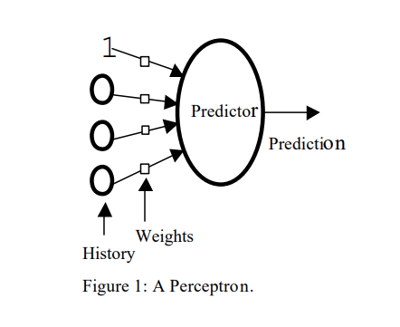
A sample perceptron figure:

Slide 88
Types of Branch Predictors that uses Neural Networks:
There are two different types of branch predictors that uses Neural Networks.
They are
Static Branch Prediction with neural networks
Dynamic Branch prediction with Neural networks.

Slide 89
Perceptron Predictor:
The perceptron predictor uses a simple neural network, the perceptron instead of a two-bit counter. It learns a target boolean function input f(x1, x2,…, xn) to predict whether a particular branch will be used.
These x are the bits of the global branch history shift register. x is bipolar, −1 represents the untaken result, and 1 represents the obtained result. A perceptron is represented as a weighted vector w0, w1,…, wn.
Here, the weights are signed integers. The output is calculated as the dot product of the weight vectors w0, w1,…, wn and the input vectors x0, x1,…, xn (x0 gives a biased input and is always set to 1).
The y output of a perceptron is: y=w₀+∑_{i=o} ^{n}wi∗xi

Slide 90
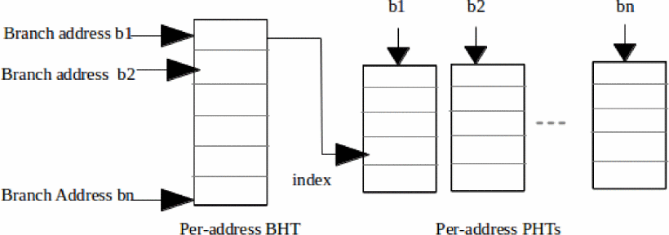
Block diagram of a perceptron predictor internals.

Slide 91
Training Perceptrons
once the output of the perceptron has been computed there, the following algorithm is used to train the perceptron. Let t be -1 if the branch was not taken, or 1 if it was taken, and let θ be the threshold, a parameter to the training algorithm used to decide when enough training has been done
Since t and x are in every case either - 1 or 1, this calculation increases the weights when the branch result concurs with xi, and decrements the weights when it clashes.

Slide 92
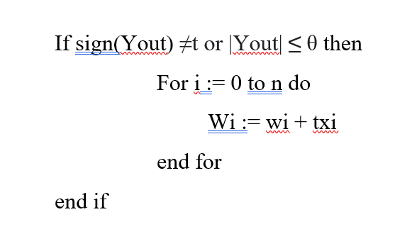
Training Perceptrons

Slide 93
Methodology:
Perceptron is used to find out the correlation between the results of a particular branch in global history and the behavior of the current branch.
These correlations are represented by weights.
The higher the weight, the stronger the correlation, and the more specific branches of the overall history contribute to the prediction of the current branch.

Slide 94
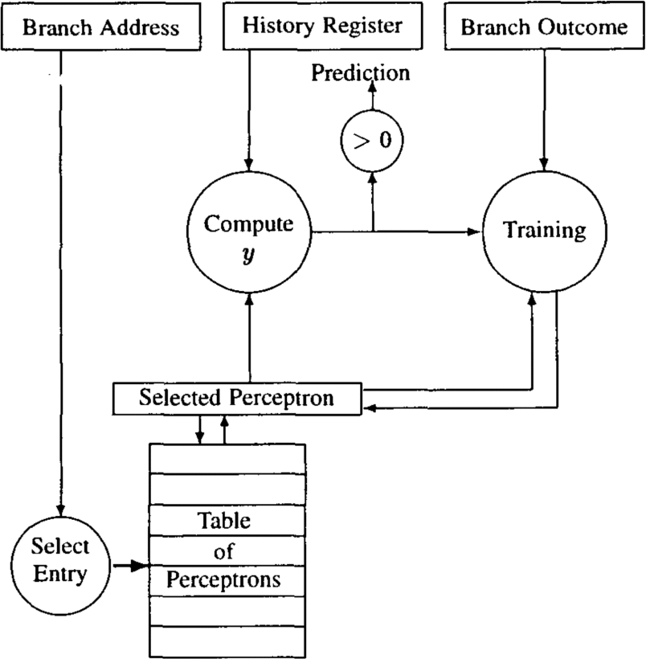
Block diagram for the perceptron predictor

Slide 95
Tuning the predictors:
We use a composite trace of the initial 10 million parts of every SPEC 2000 benchmark to tune the boundaries of every predictor for a variety of hardware budgets.
For the perceptron predictor, we find, for each history length, the best value of the threshold by using an intelligent search of the space of values, pruning areas of the space that give poor performance.

Slide 96
Performance results
The harmonized means of prediction rates are obtained with increasing hardware budgets on the SPEC 2000 benchmarks. The advantage of the perceptron predictor over PHT methods is greatest with a hardware budget of 4K bytes. , where the perceptron predictor had a prediction error rate of 6.89%, a 10.1% improvement over gshare and 8.2% over dual mode.

Slide 97
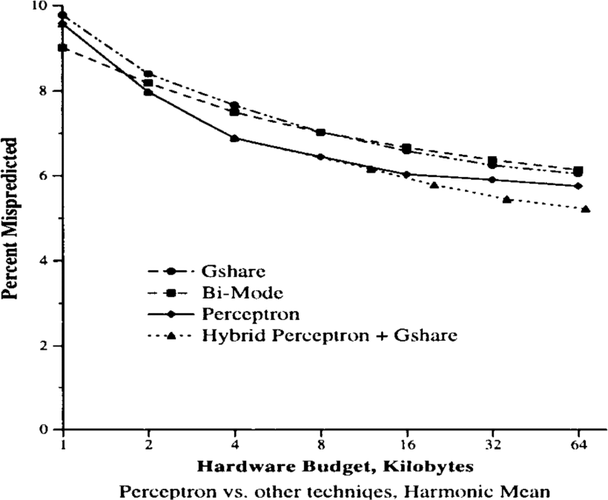
Perceptrons Performance

Slide 98
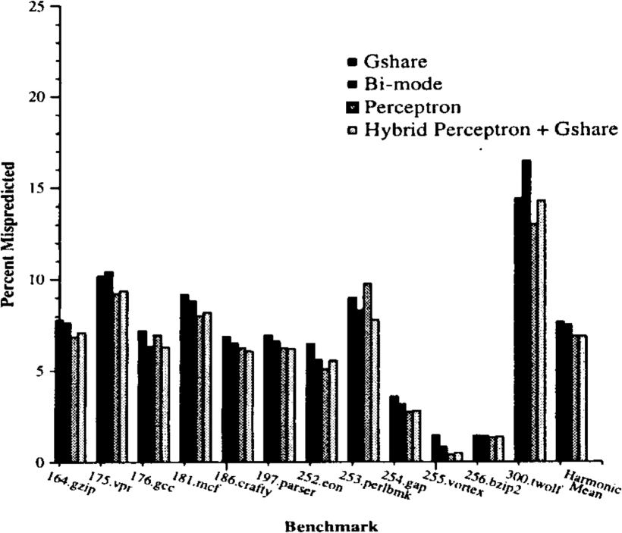
Training Times

Slide 99
Advantages and Disadvantages:
Limitations:
The output values ​​of a perceptron can only take one of two values ​​(-1 or 1) due to the hardlimit transfer function.
perceptron can only classify the set of linearly separable vectors.
Advantages:
A key benefit of our methodology is its capacity to use long branch history lengths.

Slide 100
Observations:
In this paper we have presented a new branch predictor that utilizes neural networks-the perceptron specifically as the fundamental prediction mechanism.
An expected shortcoming of perceptrons is their expanded computational complexity when contrasted with two-bit counters. However, we have shown how a perceptron predictor can be executed proficiently regarding both area and delay.
Perceptron predictor rather performs especially well on two classes of branches-those that are linearly separable and those that require long history lengths-that address countless dynamic branches.
perceptrons have intriguing qualities that open up new roads for future work. Since the perceptron predictor has various qualities and shortcomings from counter-based predictors, new hybrid plans can be created.

Slide 101
Comparison of all five branch predictors

Slide 102
Experiment
Six different storage budgets are involved in CBP-2 benchmarks, likely 2 KB,4 KB,8 KB,16 KB,32 KB and 64 KB.^{[1]}
Five different predictors namely GShare, a local history based Two-Level predictor, ISL-TAGE, LTAGE and Perceptron are implemented for all these storage budgets.^{[10]}

Slide 103
Metrics for comparison
There are two metrics of comparison for all the five predictors over different CPB-2 benchmarks and different storage budgets for each benchmark which are-
Mis-prediction Per Kilo Instructions (MPKI)
latency

Slide 104
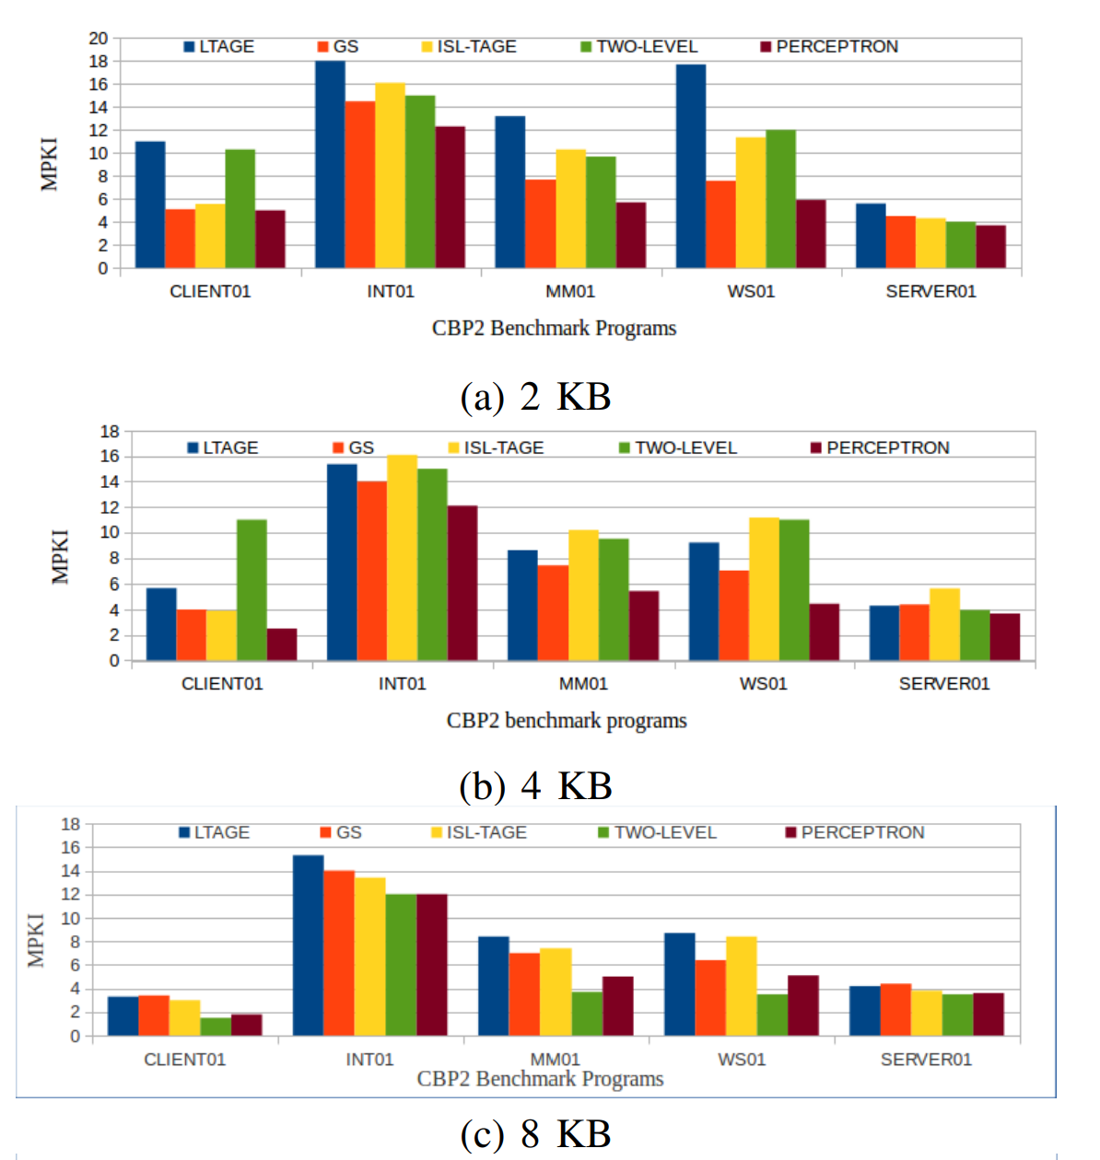
Results (based on MPKI metric)

Slide 105
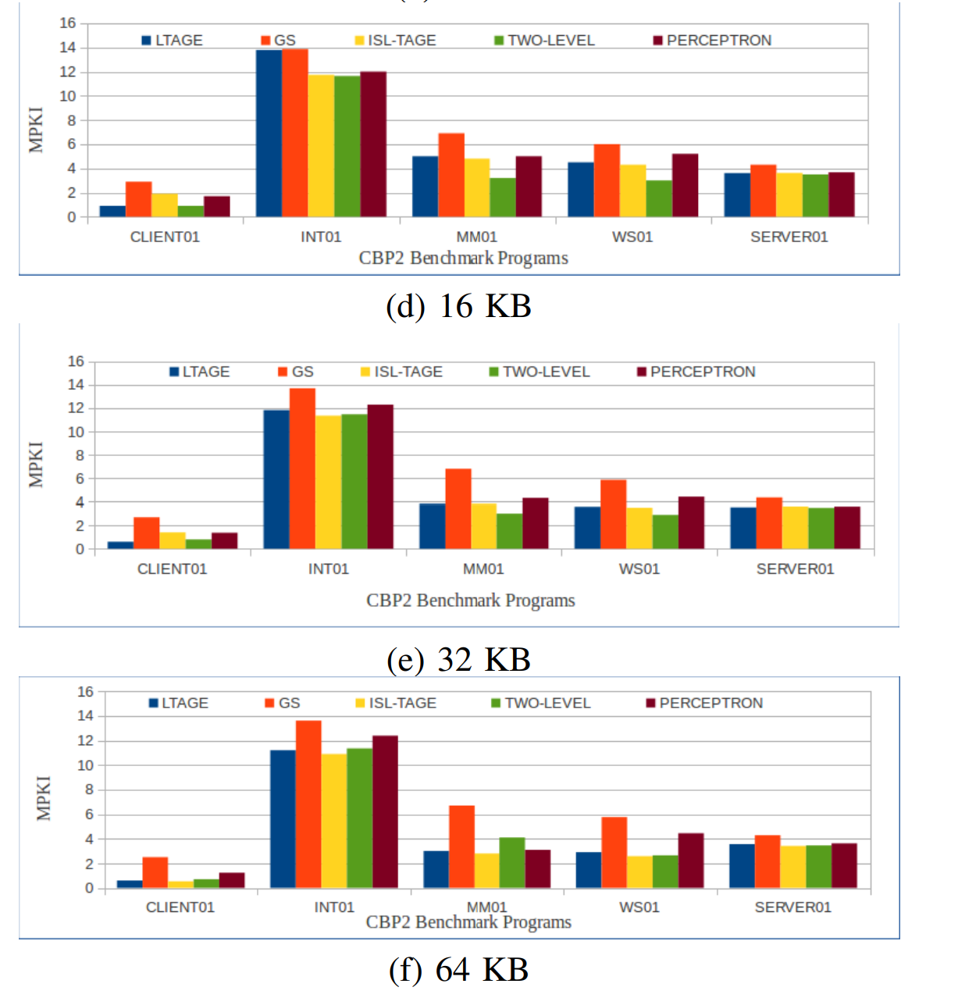
Results (based on MPKI metric)

Slide 106
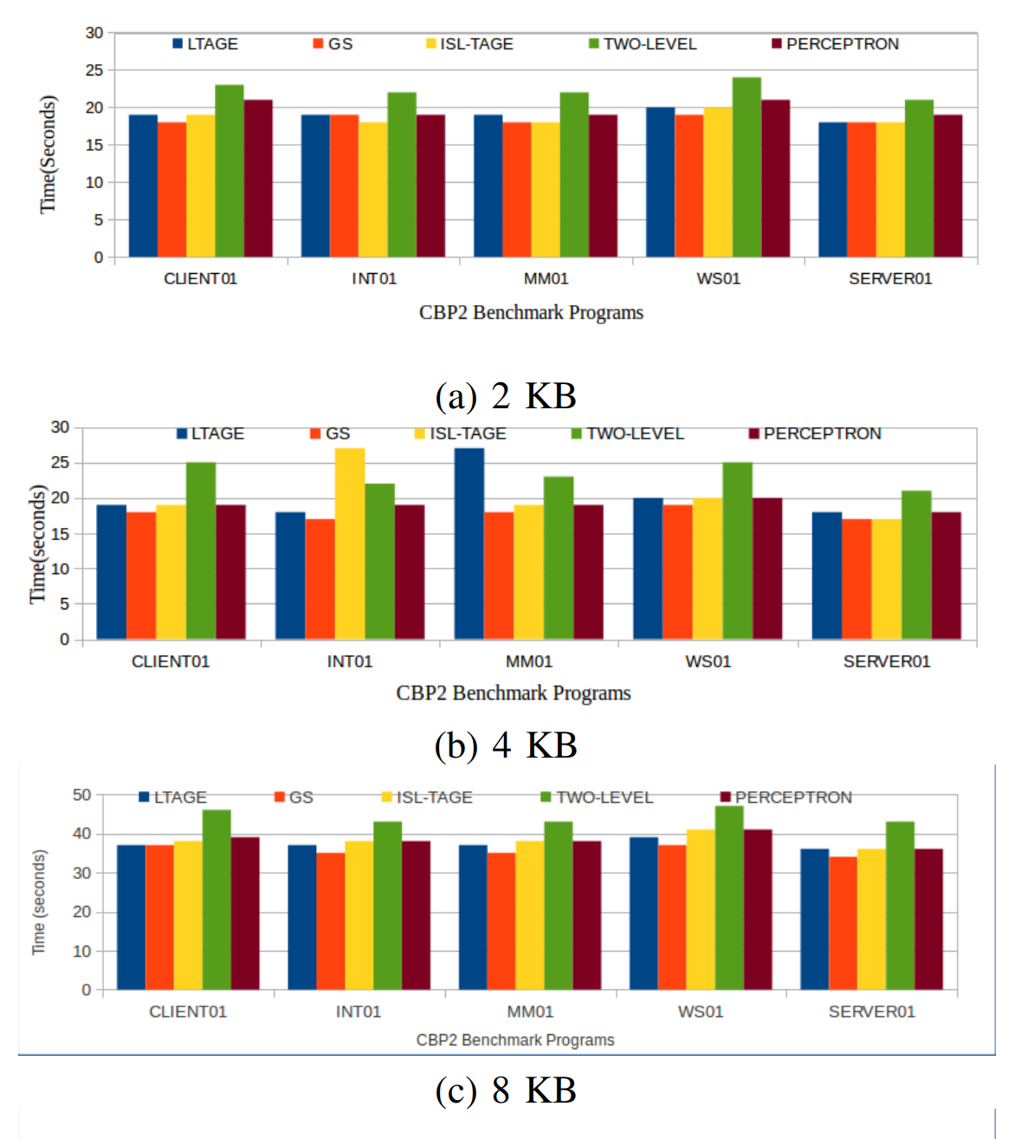
Results (based on Latency metric)

Slide 107
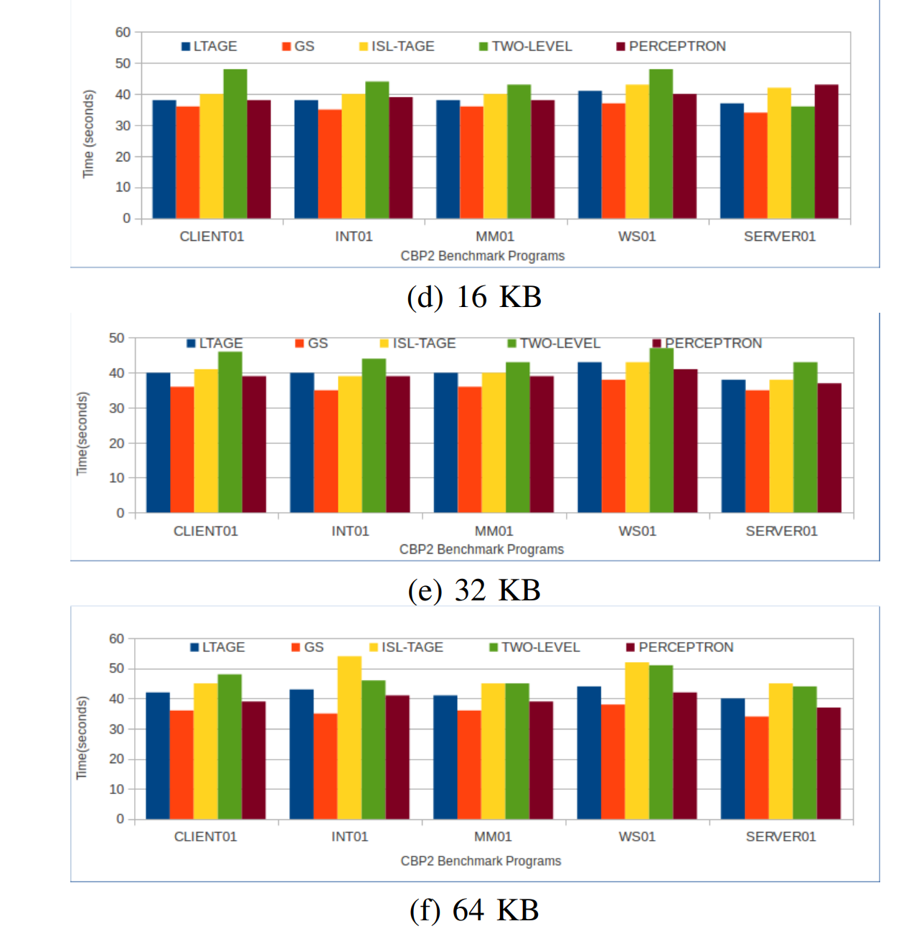
Results (based on Latency metric)

Slide 108
Conclusion and Observations
From Results,
The predictor with the lowest MPKI at a particular storage point can have the highest MPKI for some other storage point.
LTAGE has the highest MPKI for all the CBP-2 traces with 2 KB storage size where as, it does not have the same for all the programs for other storage sizes.
For the storage size greater than 16KB, LTAGE and ISL-TAGE performed well.
The performance of a two-level predictor and perceptron are better for low storage budget compared to that of the LTAGE and ISL-TAGE.

Slide 109
Conclusion and Observations
The latency doesn’t largely vary across the points.
The two-level predictor has the highest latency compared to that of the other predictors for all the storage sizes.
The perceptron predictor has the lowest MPKI as well as its latency is also comparable with the other predictors.
Predictors included in modern processors may not always be the best choice for the embedded processors with less storage.

Slide 110
References
[1]M. Das, A. Banerjee and B. Sardar, "An empirical study on performance of branch predictors with varying storage budgets," 2017 7th International Symposium on Embedded Computing and System Design (ISED), 2017, pp. 1-5, doi: 10.1109/ISED.2017.8303913.
[2]D. A. Jimenez and C. Lin, "Dynamic branch prediction with perceptrons," Proceedings HPCA Seventh International Symposium on High-Performance Computer Architecture, 2001, pp. 197-206, doi: 10.1109/HPCA.2001.903263.
[3]https://courses.cs.washington.edu/courses/cse548/02wi/files/pdf/final/Kevin-and-Nick.pdf
[4]https://en.wikipedia.org/wiki/Branch_predictor#Two-level_neural_predictor
[5]https://cseweb.ucsd.edu/classes/fa11/cse240A-a/Slides1/08_branchprediction.pdf
[6] https://people.eecs.berkeley.edu/~kubitron/courses/cs252-F00/handouts/papers/p52-evers.pdf
[7]https://citeseerx.ist.psu.edu/viewdoc/download?doi=10.1.1.91.7916&rep=rep1&type=pdf

Slide 111
References
[8] T.-Y. Yeh et al. Alternative implementations of two-level adaptive branch prediction. ACM SIGARCH Computer Architecture News, 20(2):124–134, 1992.
[9]T.-Y. Yeh et al. A comparison of dynamic branch predictors that use two levels of branch history. In ACM SIGARCH Computer Architecture News, volume 21, pages 257–266. ACM, 1993
[10] C. B. P. (CBP-2). 2nd jilp workshop on computer architecture competitions. https://www.jilp.org/jwac-2/
[11] A 64 Kbytes ISL-TAGE branch predictor (inria.fr)
[12] An empirical study on performance of branch predictors with varying storage budgets | IEEE Conference Publication | IEEE Xplore (oclc.org)
[13] https://ssine.ink/en/posts/tage-predictor/
[14] https://www.irisa.fr/caps/people/seznec/L-TAGE.pdf
[15] https://ssine.ink/en/posts/tage-predictor/
[16] https://github.com/sudoRicheek/amdahls-vandals

Slide 112
THANK YOU

